Slide 1
SC-200T00A Microsoft Security Operations Analyst
Author name Date

Slide 2
Module 3: Mitigate threats using Azure Defender

Slide 3
Module agenda
Plan for cloud workload protections using Azure Defender
Explain cloud workload protections in Azure Defender
Connect Azure assets to Azure Defender
Connect non-Azure resources to Azure Defender
Remediate security alerts using Azure Defender

Slide 4
Lesson 1: Plan for cloud workload protections using Azure Defender

Slide 5
Lesson introduction
After this lesson, you will be able to:
Describe Azure Defender features
Explain Azure Security Center features
Enable Azure Defender

Slide 6
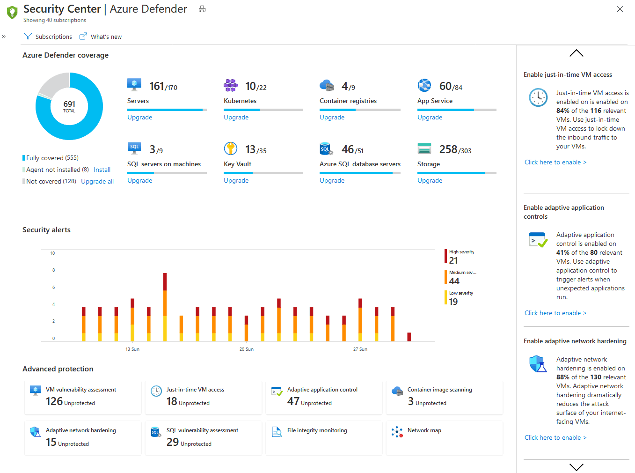
Explain Azure Defender
Azure Defender, brings advanced, intelligent protection to your Azure and hybrid resources and workloads.
Notes:
Azure Defender is the Cloud workload protection feature of Azure Security Center. Azure Security Center's features cover the two broad pillars of cloud security:
Cloud Security Posture Management (CSPM) - Security Center is available for free to all Azure users. The free experience includes CSPM features such as secure score, detection of security misconfigurations in your Azure machines, asset inventory, and more. Use these CSPM features to strengthen your hybrid cloud posture and track compliance with built-in policies.
Cloud Workload Protection (CWP) - Security Center's integrated cloud workload protection platform (CWPP), Azure Defender, brings advanced, intelligent protection to your Azure and hybrid resources and workloads. Enabling Azure Defender brings a range of extra security features. In addition to the built-in policies, when you've enabled any Azure Defender plan, you can also add custom policies and initiatives.

Slide 7
Explain Azure Security Center
Strengthen security posture
Manage organization security policy and compliance
Continuous assessments
Optimize and improve security by configuring recommended controls
Network map
Automatically discover and onboard Azure resources with automatic provisioning

Slide 8
Guided demonstration – Azure Security Center
Scenario:
You are the security operations analyst and must protect your hybrid cloud with Azure Security Center.
Task 1
Manage cloud security posture
Task 2
Protect against threats
Task 3
Get advanced insights
Notes:
This recorded demo is provided to give learners a sense of Azure Security Center.
Follow the annotations and advice for where to click.
Time required: 19 minutes
Guided demo link: https://mslearn.cloudguides.com/guides/Protect%20your%20hybrid%20cloud%20with%20Azure%20Security%20Center

Slide 9
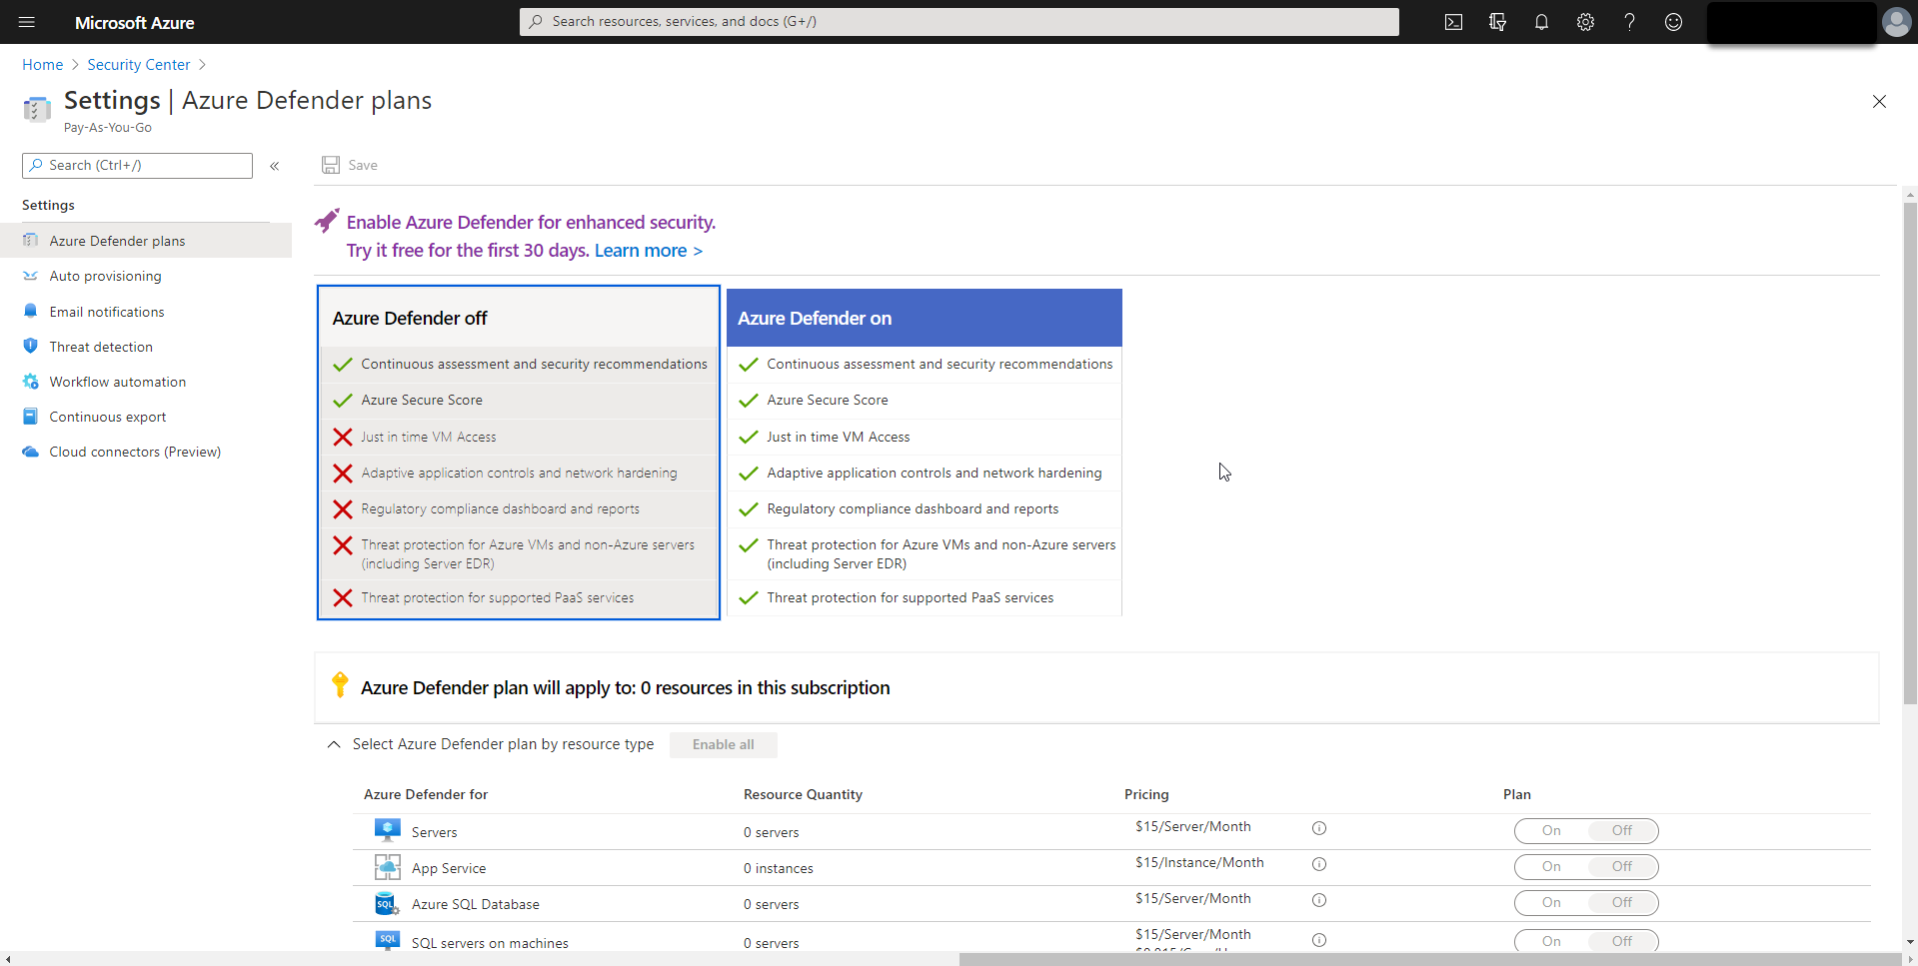
Enable Azure Defender
To enable Azure Defender, you first enable Azure Security Center, then Azure Defender, and finally configure your coverage type.
Notes:
Azure Defender is the Cloud workload protection feature of Azure Security Center. Azure Security Center's features cover the two broad pillars of cloud security:
Cloud Security Posture Management (CSPM) - Security Center is available for free to all Azure users. The free experience includes CSPM features such as secure score, detection of security misconfigurations in your Azure machines, asset inventory, and more. Use these CSPM features to strengthen your hybrid cloud posture and track compliance with built-in policies.
Cloud Workload Protection (CWP) - Security Center's integrated cloud workload protection platform (CWPP), Azure Defender, brings advanced, intelligent protection to your Azure and hybrid resources and workloads. Enabling Azure Defender brings a range of extra security features. In addition to the built-in policies, when you've enabled any Azure Defender plan, you can also add custom policies and initiatives.
Instructor demonstration:
- Enable Azure Defender

Slide 10
Section break

Slide 11
Lesson 2: Explain cloud workload protections in Azure Defender

Slide 12
Lesson introduction
After this lesson, you will be able to:
Explain which workloads are protected by Azure Defender
Describe the benefits of the protections offered by Azure Defender
Explain how Azure Defender protection's function

Slide 13
Azure Defender for servers
Azure Defender for servers adds threat detection and advanced defenses for your Windows and Linux machines.
For Windows, Azure Defender integrates with Azure services to monitor and protect your Windows-based machines. Security Center presents the alerts and remediation suggestions from all of these services in an easy-to-use format.
For Linux, Azure Defender collects audit records from Linux machines by using auditd, one of the most common Linux auditing frameworks. auditd lives in the mainline kernel.

Slide 14
Azure Defender for App Service
Azure Defender for App Service uses the scale of the cloud to identify attacks targeting applications running over App Service.
Attackers probe web applications to find and exploit weaknesses. Before being routed to specific environments, requests to applications running in Azure go through several gateways, where they're inspected and logged.
This data is then used to identify exploits and attackers and learn new patterns that will be used later.

Slide 15
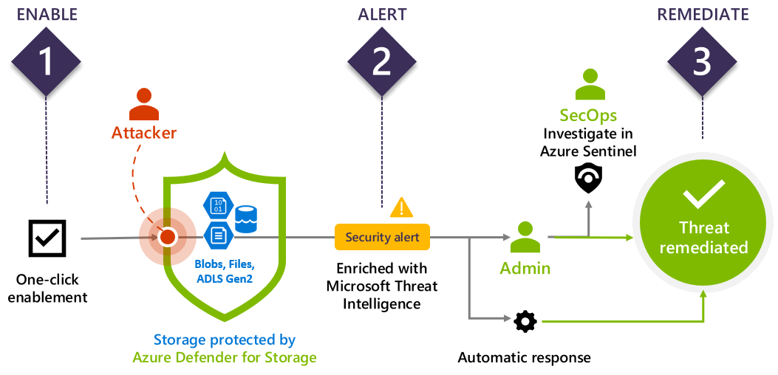
Azure Defender for Storage

Slide 16
Azure Defender for SQL
Azure Defender for SQL comprises two separate Azure Defender plans:
Azure Defender for Azure SQL database servers protects:
Azure SQL Database
Azure SQL Managed Instance
Dedicated SQL pool in Azure Synapse
Azure Defender for SQL servers on machines extends the protections for your Azure-native SQL Servers to fully support hybrid environments and protect SQL servers (all supported version) hosted in Azure, other cloud environments, and even on-premises machines:
SQL Server on Virtual Machines
On-premises SQL servers:
Azure Arc enabled SQL Server (preview)
SQL Server running on Windows machines without Azure Arc

Slide 17
Azure Defender for Key Vault
Azure Defender detects unusual and potentially harmful attempts to access or exploit Key Vault accounts. This layer of protection allows you to address threats without being a security expert and without the need to manage third-party security monitoring systems.

Slide 18
Azure Defender for Resource Manager
Azure Defender for Resource Manager automatically monitors the resource management operations in your organization, whether they're performed through the Azure portal, Azure REST APIs, Azure CLI, or other Azure programmatic clients. Azure Defender runs advanced security analytics to detect threats and alert you about suspicious activity.

Slide 19
Azure Defender for DNS
Azure Defender for DNS provides an extra layer of protection for your cloud resources by:
Continuously monitoring all DNS queries from your Azure resources
Running advanced security analytics to alert you about suspicious activity

Slide 20
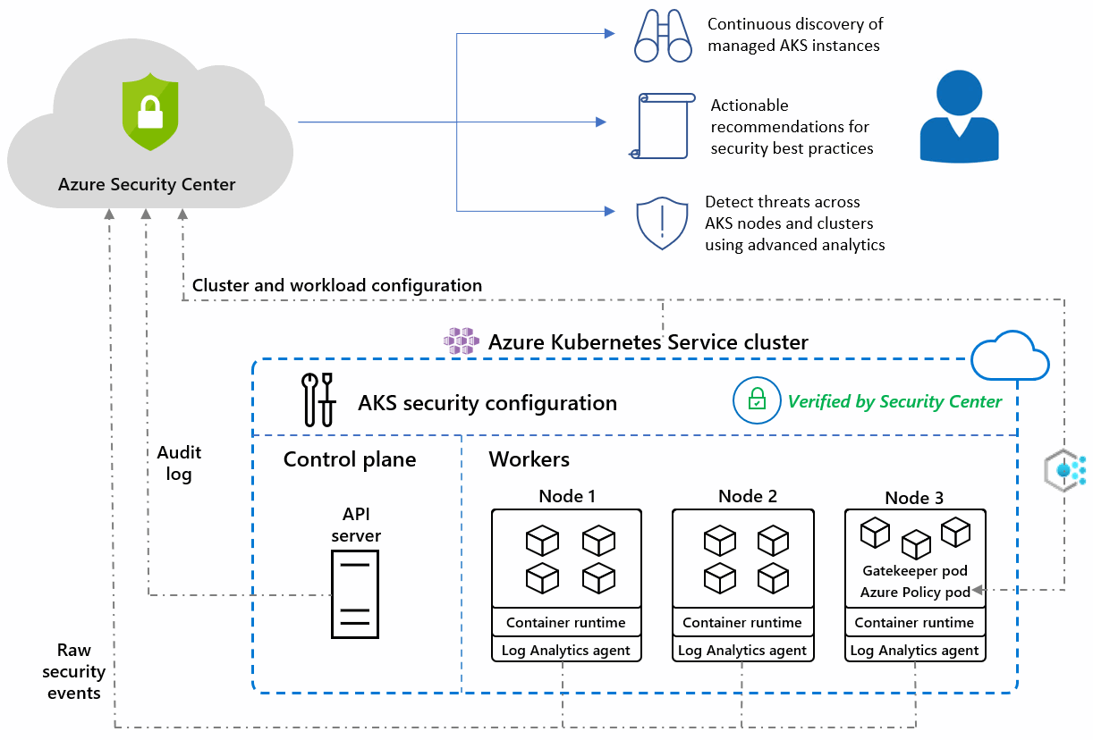
Azure Defender for Kubernetes

Slide 21
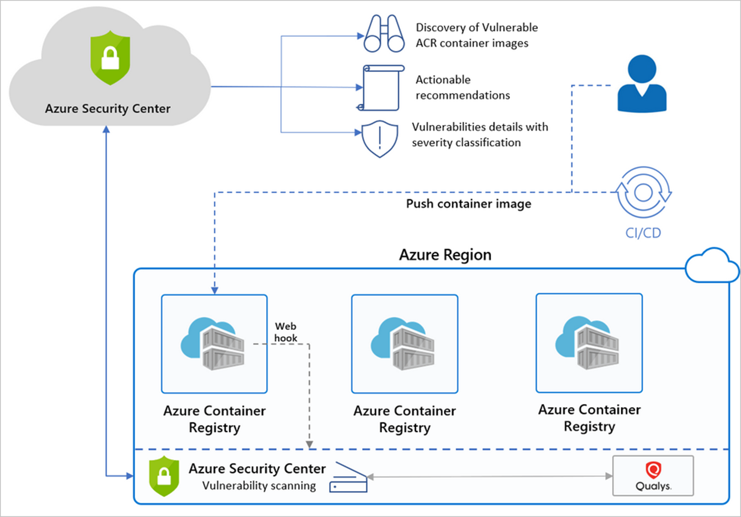
Azure Defender for container registries

Slide 22
Azure Defender additional protections
Threat protection for Azure network layer
Threat protection for Azure Cosmos DB
Threat protection for Azure WAF
Threat protection for Azure DDoS Protection

Slide 23
Section break

Slide 24
Lesson 3: Connect Azure assets to Azure Defender

Slide 25
Lesson introduction
After this lesson, you will be able to:
Explore Azure assets
Configure auto-provisioning in Azure Defender
Describe manual provisioning in Azure Defender

Slide 26
Explore and manage your resources with asset inventory
Inventory Summary Status For each Resource
Total Resources
Agent monitoring
Unhealthy Resources
Azure Defender
Unmonitored Resources
Body Recommendations
Unregistered Subscriptions

Slide 27
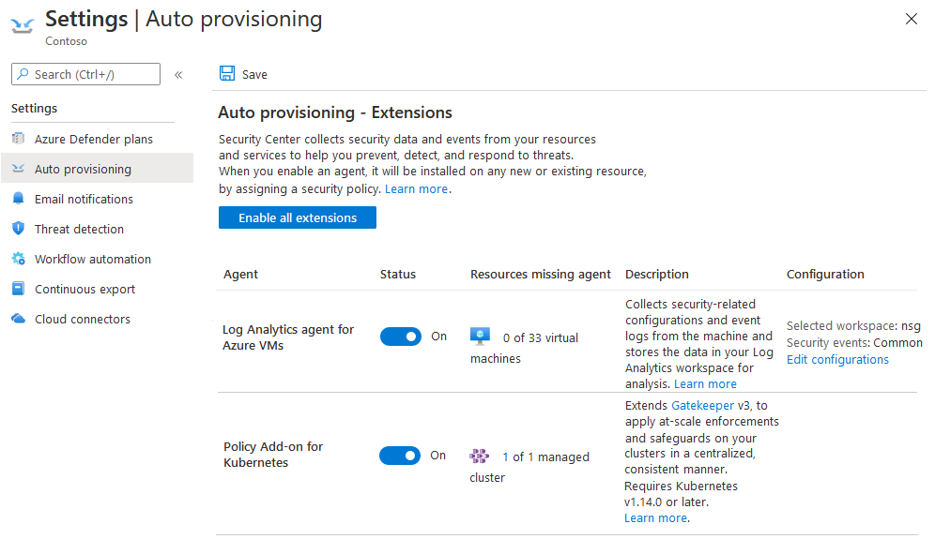
Configure auto provisioning
Security Center collects data from your Azure virtual machines (VMs), virtual machine scale sets, IaaS containers, and non-Azure (including on-premises) machines to monitor for security vulnerabilities and threats.

Slide 28
Manual log analytics agent provisioning
If you turn off auto provisioning of the agent. You will need to manually install the Log Analytics agent on Virtual Machines.
Notes:
Instructor demonstration:
Explore Inventory
Configure Provisioning

Slide 29
Section break

Slide 30
Lesson 4: Connect non-Azure resources to Azure Defender

Slide 31
Lesson introduction
After this lesson, you will be able to:
Connect non-Azure machines to Azure Defender
Connect AWS accounts to Azure Defender
Connect GCP accounts to Azure Defender

Slide 32
Protect non-Azure resources
Protect your non-Azure servers
Protect your virtual machines in other clouds (such as AWS and GCP)
Protect SQL databases

Slide 33
Connect non-Azure machines
Azure Arc Enabled
Without Azure Arc
Install Azure Arc agent on Host
Manually deploy Log Analytics agent to Windows Host
In the Azure Portal, Connect the host.
Manually deploy Log Analytics agent to Linux Host
Manually deploy Log Analytics agent to Azure Stack VMs

Slide 34
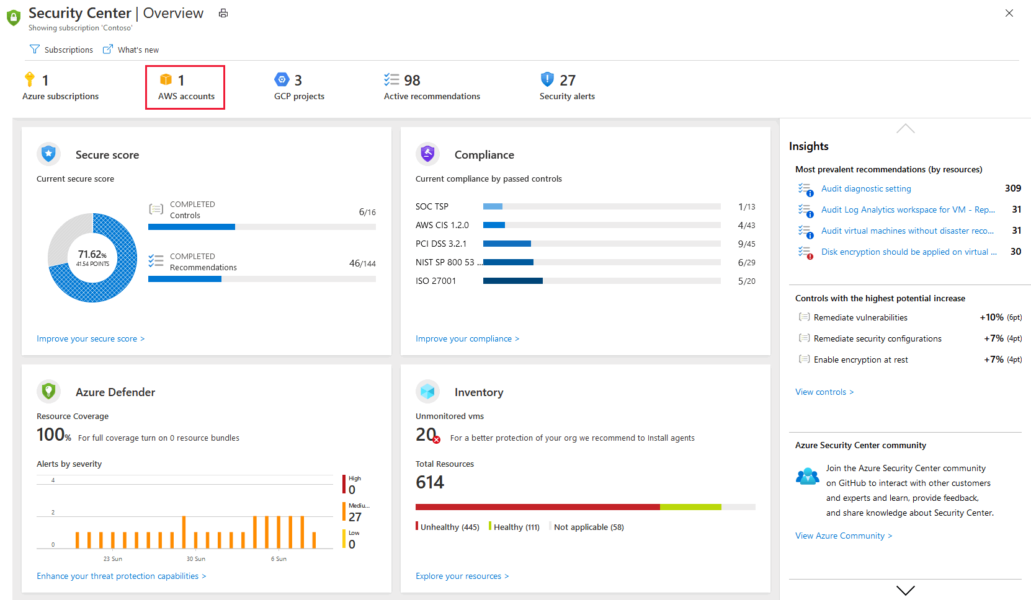
Connect AWS accounts
Onboarding your AWS account into Security Center, integrates AWS Security Hub and Azure Security Center. Security Center thus provides visibility and protection across both of these cloud environments.

Slide 35
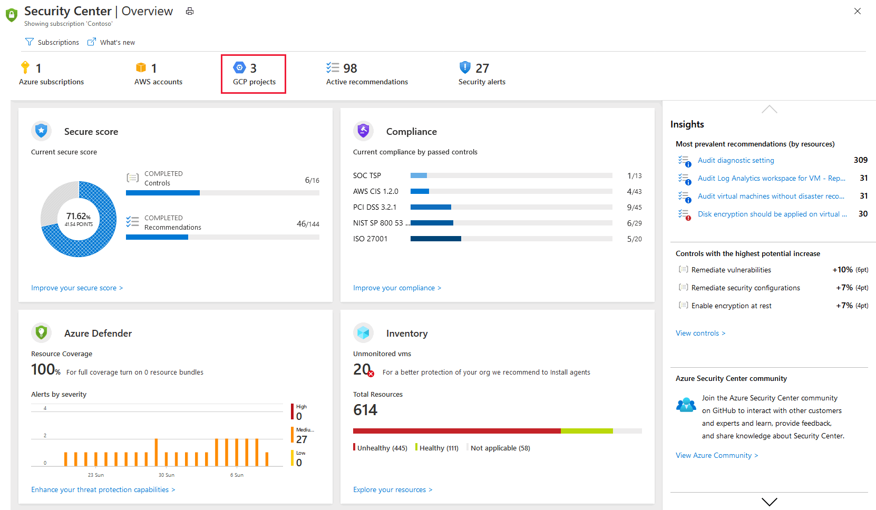
Connect your GCP accounts
Onboarding your GCP account into Security Center, integrates GCP Security Command and Azure Security Center. Security Center thus provides visibility and protection across both cloud environments.
Notes:
Instructor demonstration:
Arc Enable a VM and Connect
Connect to AWS
Connect to GCP

Slide 36
Section break

Slide 37
Lesson 5: Remediate security alerts using Azure Defender

Slide 38
Lesson introduction
After this lesson, you will be able to:
Describe alerts in Azure Defender
Remediate alerts in Azure Defender
Automate responses in Azure Defender

Slide 39
Explain security alerts
Security alerts and incidents
Detecting Threats
Alert classification
Continuous monitoring and assessments
Alert types

Slide 40
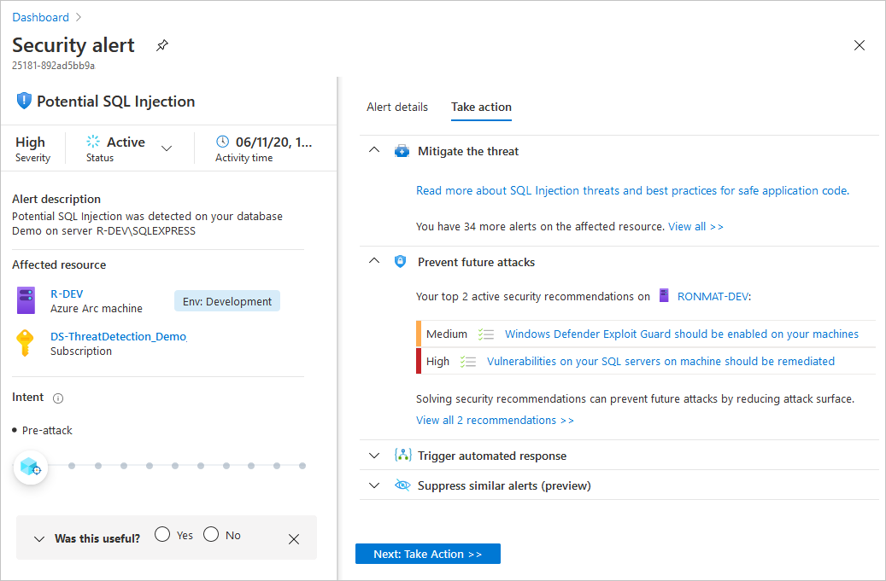
Remediate alerts
Azure Defender provides actionable tasks to mitigate the threat, prevent future attacks, trigger automated response, suppress similar alerts.

Slide 41
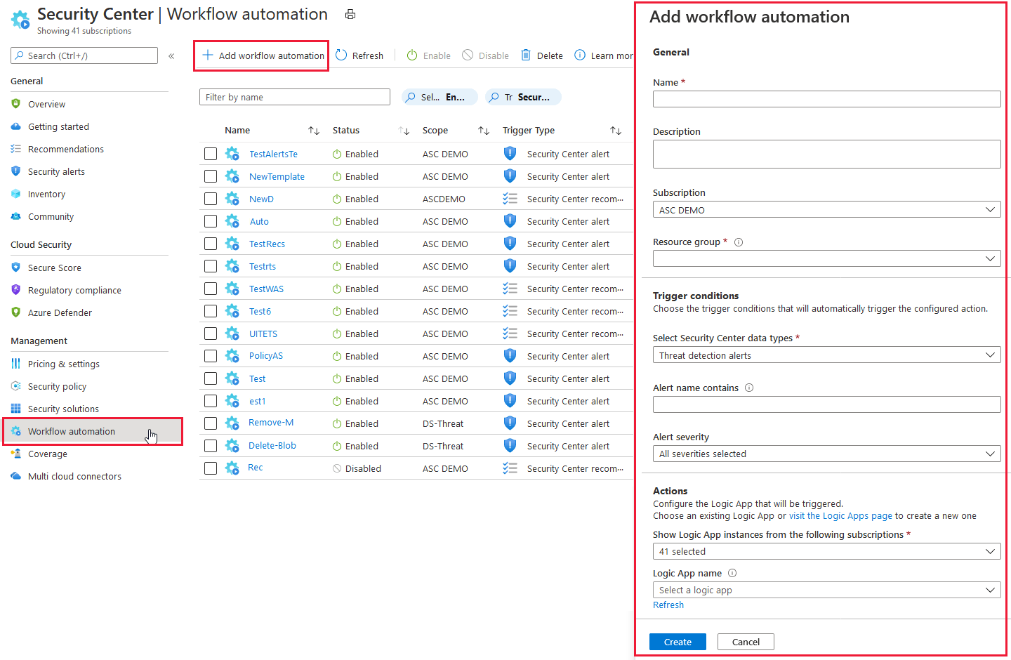
Remediate alerts (continued)
This feature can trigger Logic Apps on security alerts and recommendations.

Slide 42
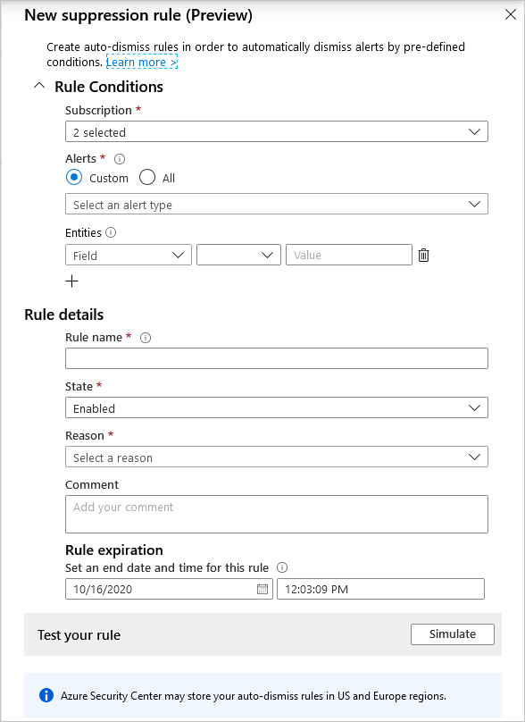
Suppress alerts from Azure Defender
A suppression rule can be useful to suppress alerts that you've identified as false positives or alerts that are being triggered too often to be useful.

Slide 43
Manage security incidents and threat intelligence reports
This feature can trigger Logic Apps on security alerts and recommendations.

Slide 44
Manage security incidents and threat intelligence reports
Reports include: Activity Group, Campaign, Threat Summary
Attacker’s identity or associations (if this information is available)
Associated indicators of compromise (IoC) such as URLs and file hashes
Victimology, which is the industry and geographic prevalence to assist you in determining if your Azure resources are at risk
Attackers’ objectives
Current and historical attack campaigns (if this information is available)
Mitigation and remediation information
Attackers’ tactics, tools, and procedures

Slide 45
Respond to alerts from Azure resources
Respond to Azure Defender for Key Vault alerts
Respond to Azure Defender for DNS alerts
Respond to Azure Defender for Resource Manager alerts
Notes:
Instructor demonstration:
Manage Alerts
Review an Alert
Automation Configuration
Rule Suppression

Slide 46
Section break

Slide 47
Knowledge check
Check your knowledge with the module quiz in your course viewer

Slide 48
Lab 01 – Mitigate threats using Azure Defender
Notes:
The labs for this module are available from your authorized lab hoster with all the other labs for this course.
Optional labs:
If you have time or would like extra interactive focus on Azure Security Center more labs are available at this link:
Azure-Security-Center/Labs at main · Azure/Azure-Security-Center (github.com)

Slide 49
Lab Exercises
1
Enable Azure Defender
2
Mitigate threats using Azure Defender

Slide 50
Closing slide

